Slide 1


Adopting git/GitHub
Vincent Yan
Date: 4/28/2022

Slide 2
Agenda
What are git and GitHub
What they can help us with
Some examples
Notes:
Goal is to convince you that git/github is a good thing and you should give a try

Slide 3

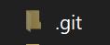
git
A distributed version control system (software)
2005

Slide 4
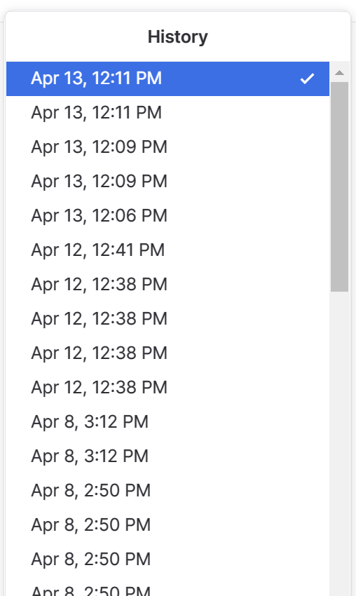
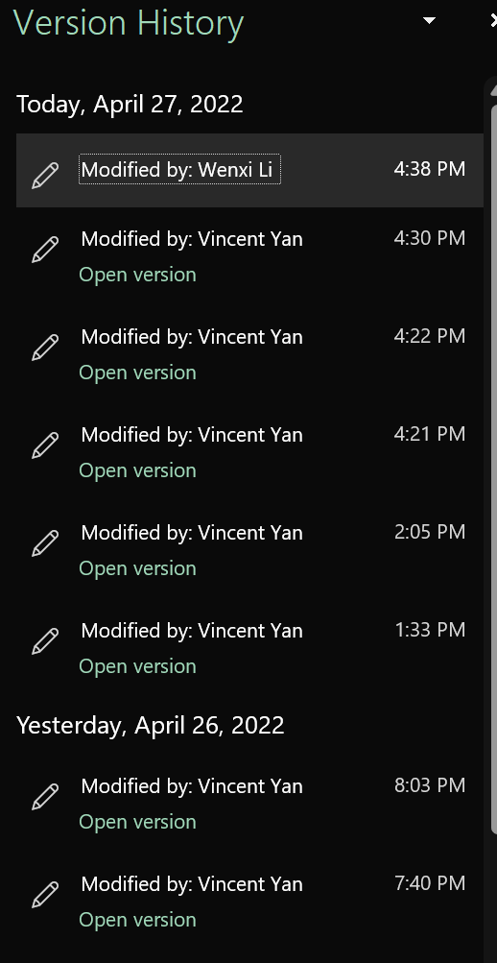
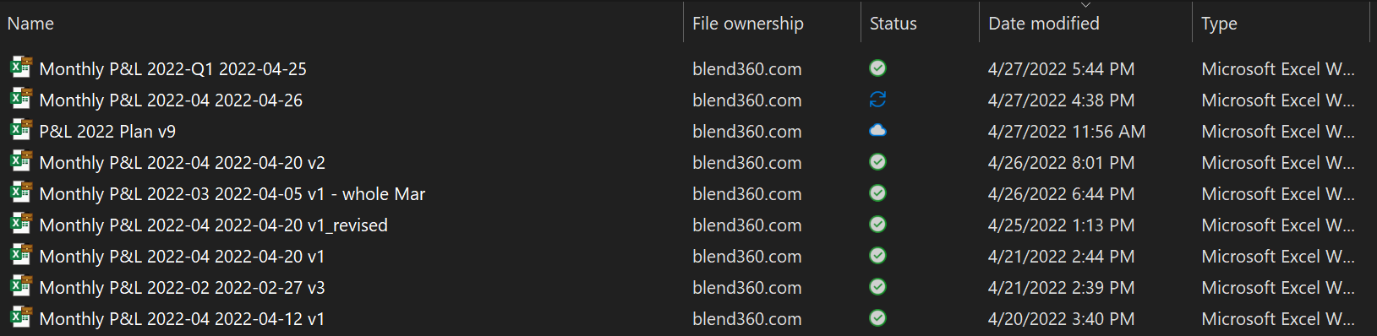
VERSION CONTROL
Not so great examples
3/1/2022
3/7/2022
3/18/2022

Slide 5
VERSION CONTROL
Better Approach
3/1/2022
3/7/2022
3/18/2022
3/25/2022
4/12/2022
time
message
First version
that works
Query one more table
Change column name
Redesign logic
Add ad-hoc column
author
Vincent
Vincent
Jack
Chris
Vincent
tag
v1.0
v1.1
v1.2
commit

Slide 6
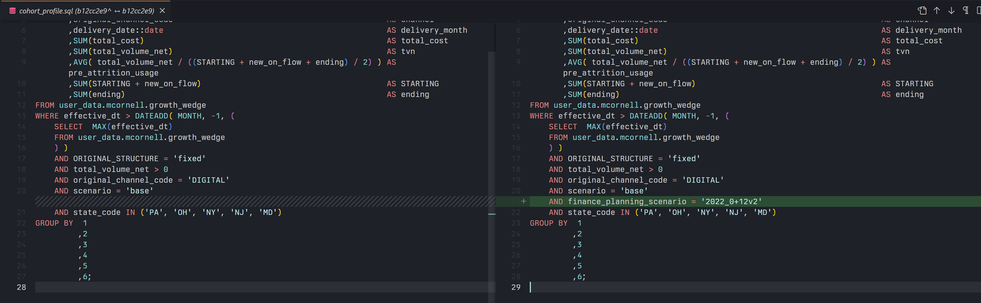
VERSION CONTROL
Text Comparison

Slide 7
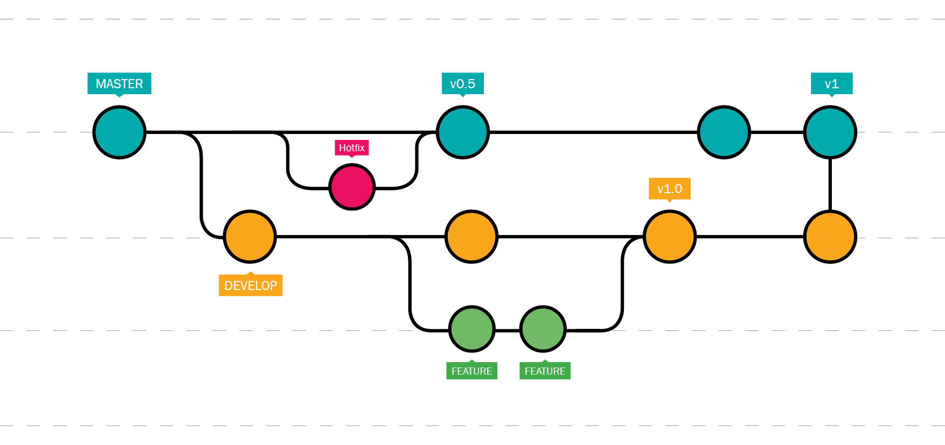
VERSION CONTROL
Branching
Used for
production
All developments
happens here
Add one single change
at a time

Slide 8
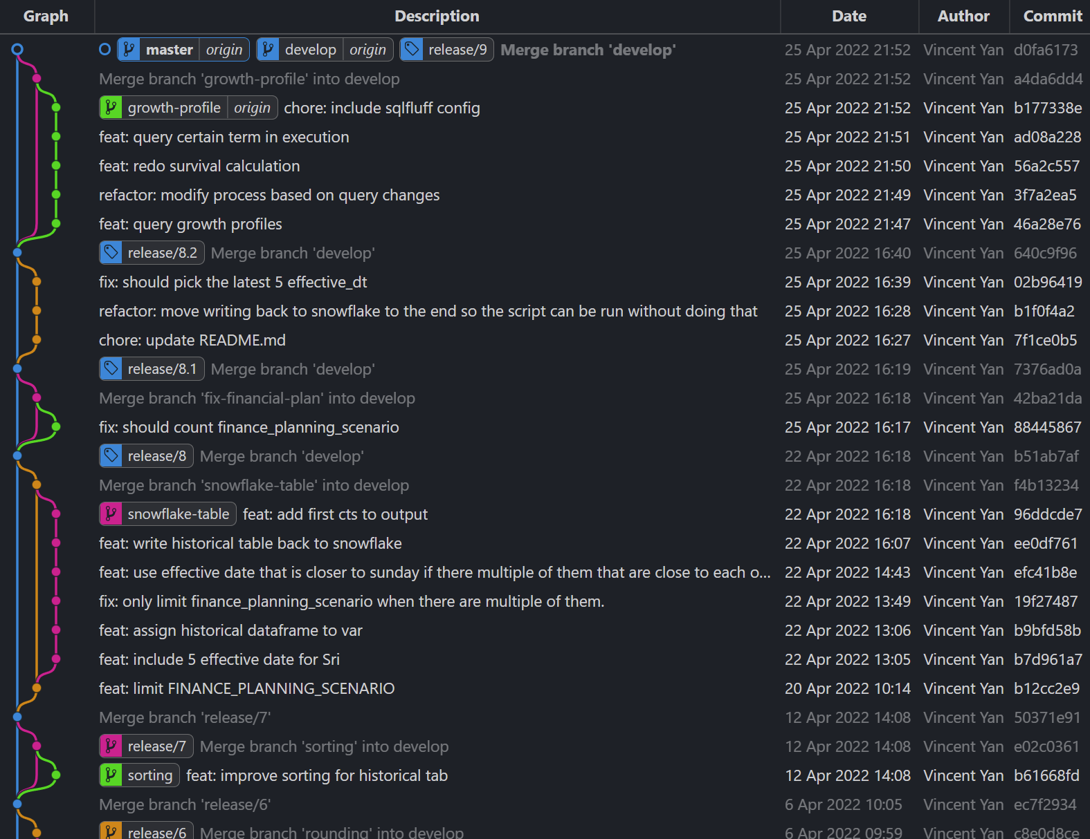
VERSION CONTROL
Best Practices
Branch Frequently, Commit Often
Make Small, Single-Purpose Commits
Write Short, Detailed Commit Messages
Preserve History and Traceability

Slide 9
DISTRIBUTED
Everything Is Inside .git Folder
hooks − This folder contains script files. Git hooks are the scripts that are executed before or after events like commit, push etc.
objects − This folder represents an object database of Git.
config − This is the local configuration file.
refs − This folder stores information about tags and branches.
HEAD − This file stores reference to the current branch. It points to the master branch by default.
index − This is a binary file and stores staging information

Slide 10
DISTRIBUTED
Push / Pull
Remote (another computer)
Pull
Push
Local (your laptop)

Slide 11
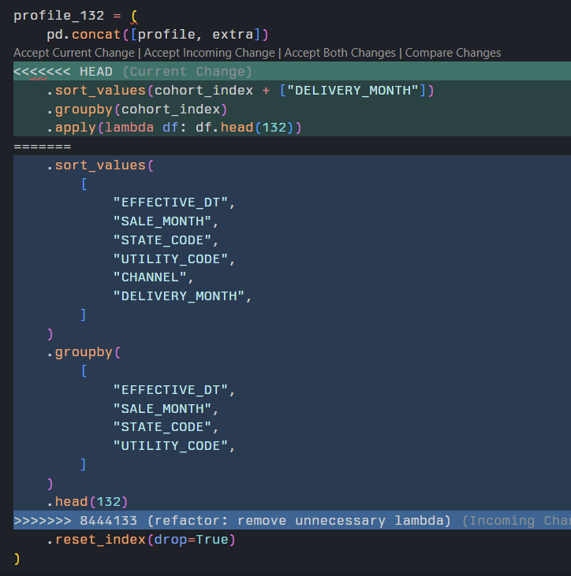
DISTRIBUTED
Solving Conflict
Git let you know if there is a conflict with friendly message
You can manually edit everything when solving a conflict
The history for this step will be preserved as well

Slide 12
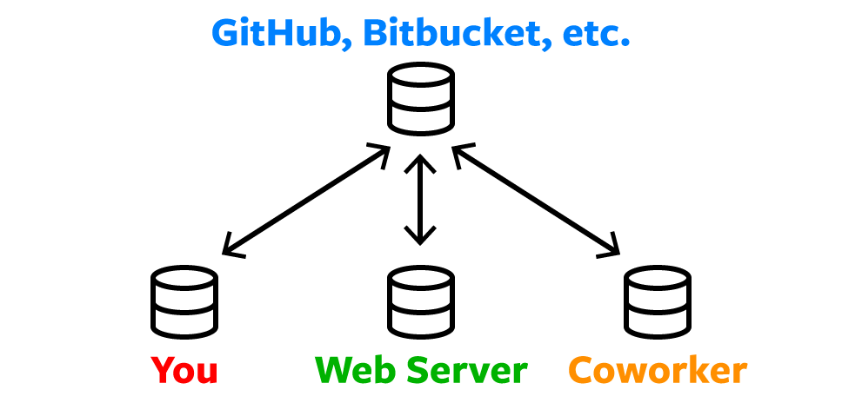
DISTRIBUTED
Syncing Between Multiple Machines

Slide 13

GitHub
A code hosting service (website) with git as version control
2008
Github.com

Slide 14

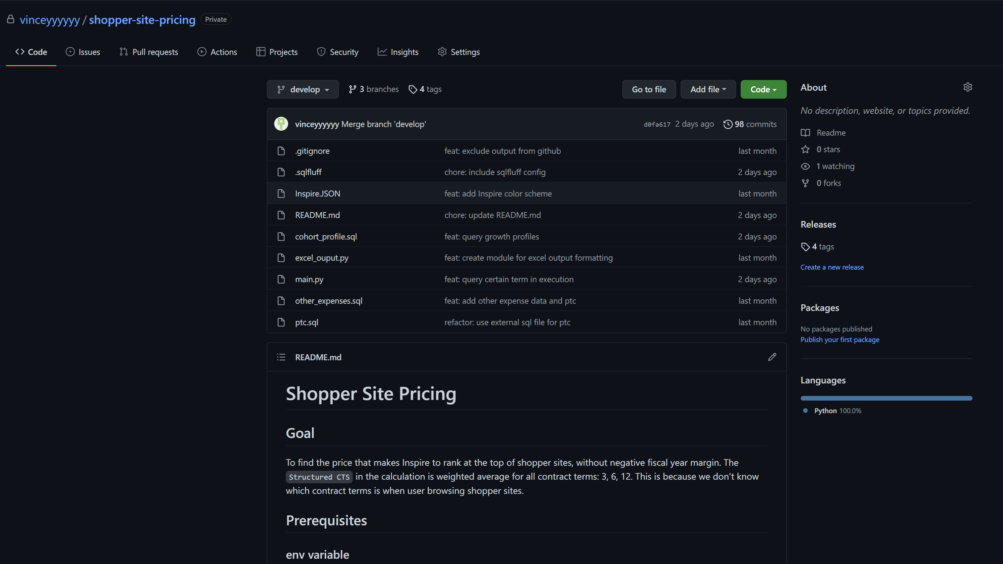
Hosting

Slide 15
PULL REQUEST
Who decides a branch could be merge?

Slide 16
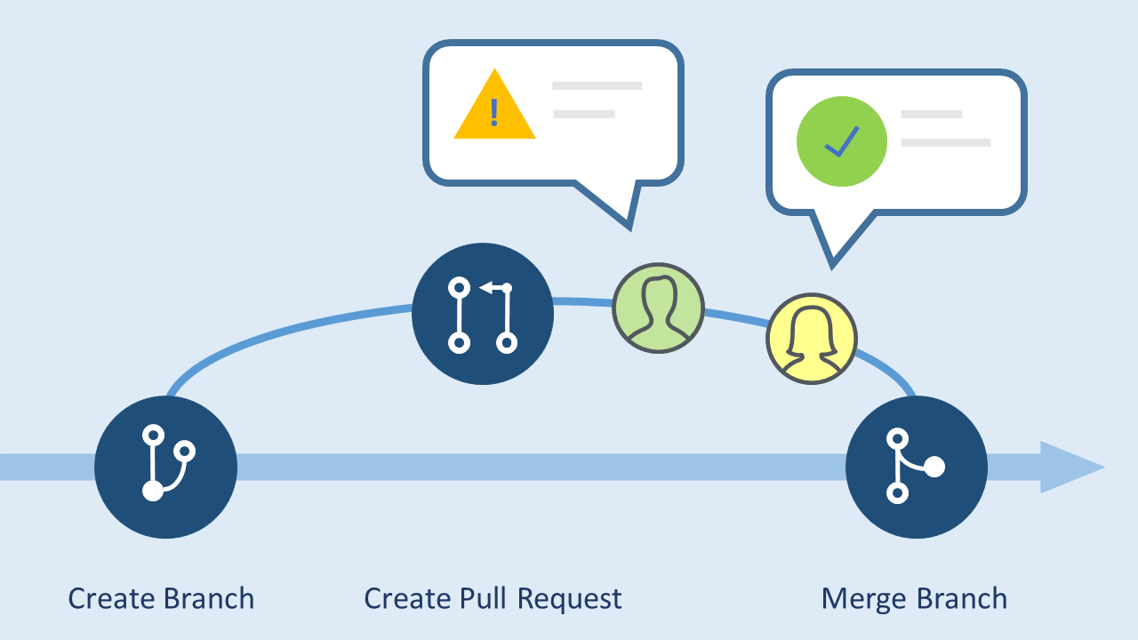
PULL REQUEST
Merge Authorization
When your branch is finished, create a pull request on GitHub.
The repo maintainer reviews the change you made:
If it is good, your branch is allowed to merge into other branches.
If it is not, you will need to make changes accordingly then continue the process.

Slide 17



Manual Sync
GitHub.com
Pull
Push
Copy all files from remote server
Edit and Commit
File with your changes

Slide 18
How can we put everything together
Snowflake

Slide 19
Requirement: weekly report with latest data
Final delivery: a .xlsx file with in-Excel calculations
Data source is a table on SnowFlake that updates weekly
.xlsx file is pre-build with heavy calculations and multiple raw data tables
.xlsx file is modified frequently, with both data changes and excel changes
Scenario #1

Slide 20
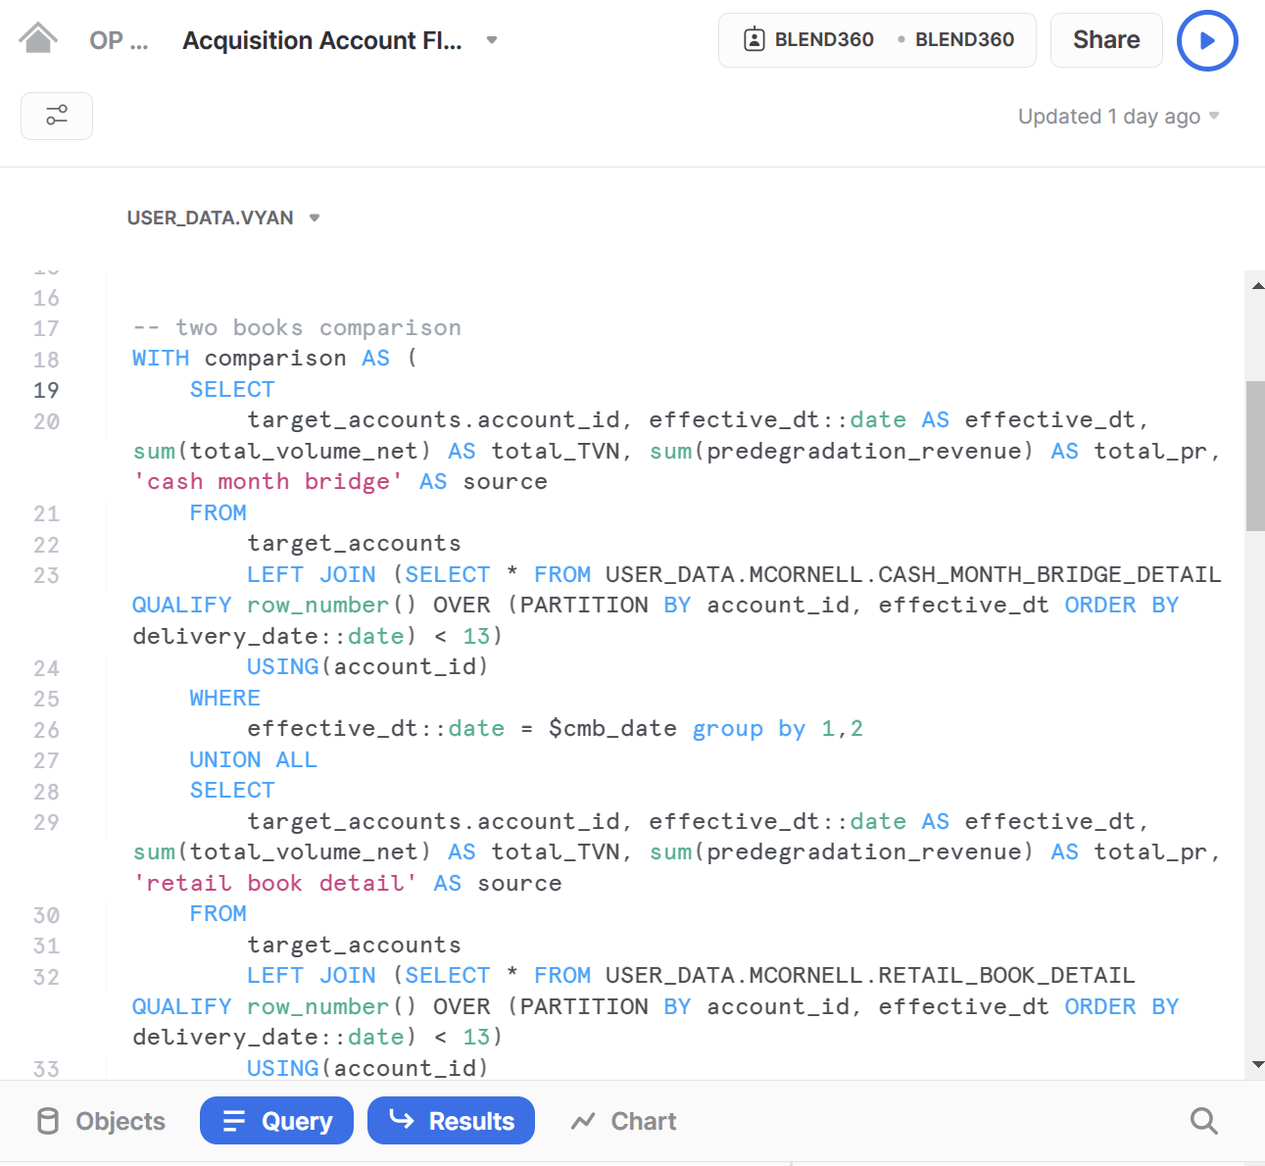
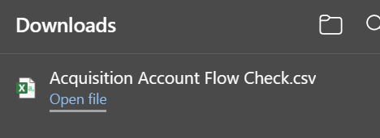
SCENARIO #1
What I use to do
1. Write, edit, test query
in SnowFlake Web UI
2. Download query result as .csv file
and copy/paste into excel file
3. Create excel report and
save .xlsx file to OneDrive
with special file name

Slide 21
SCENARIO #1
Problems I use to get
SnowFlake Web UI is not the best editor in the world
Code formatting and indentation is bad
Hard to see if content is inside the same parentheses
Force to write all queries into one worksheet, hard to locate
Copy/paste from csv to excel is error prone
Overwrites cells
Missing lines
Cannot reproduce reports to debug
History of manual operation such as copy/paste is not preserved

Slide 22
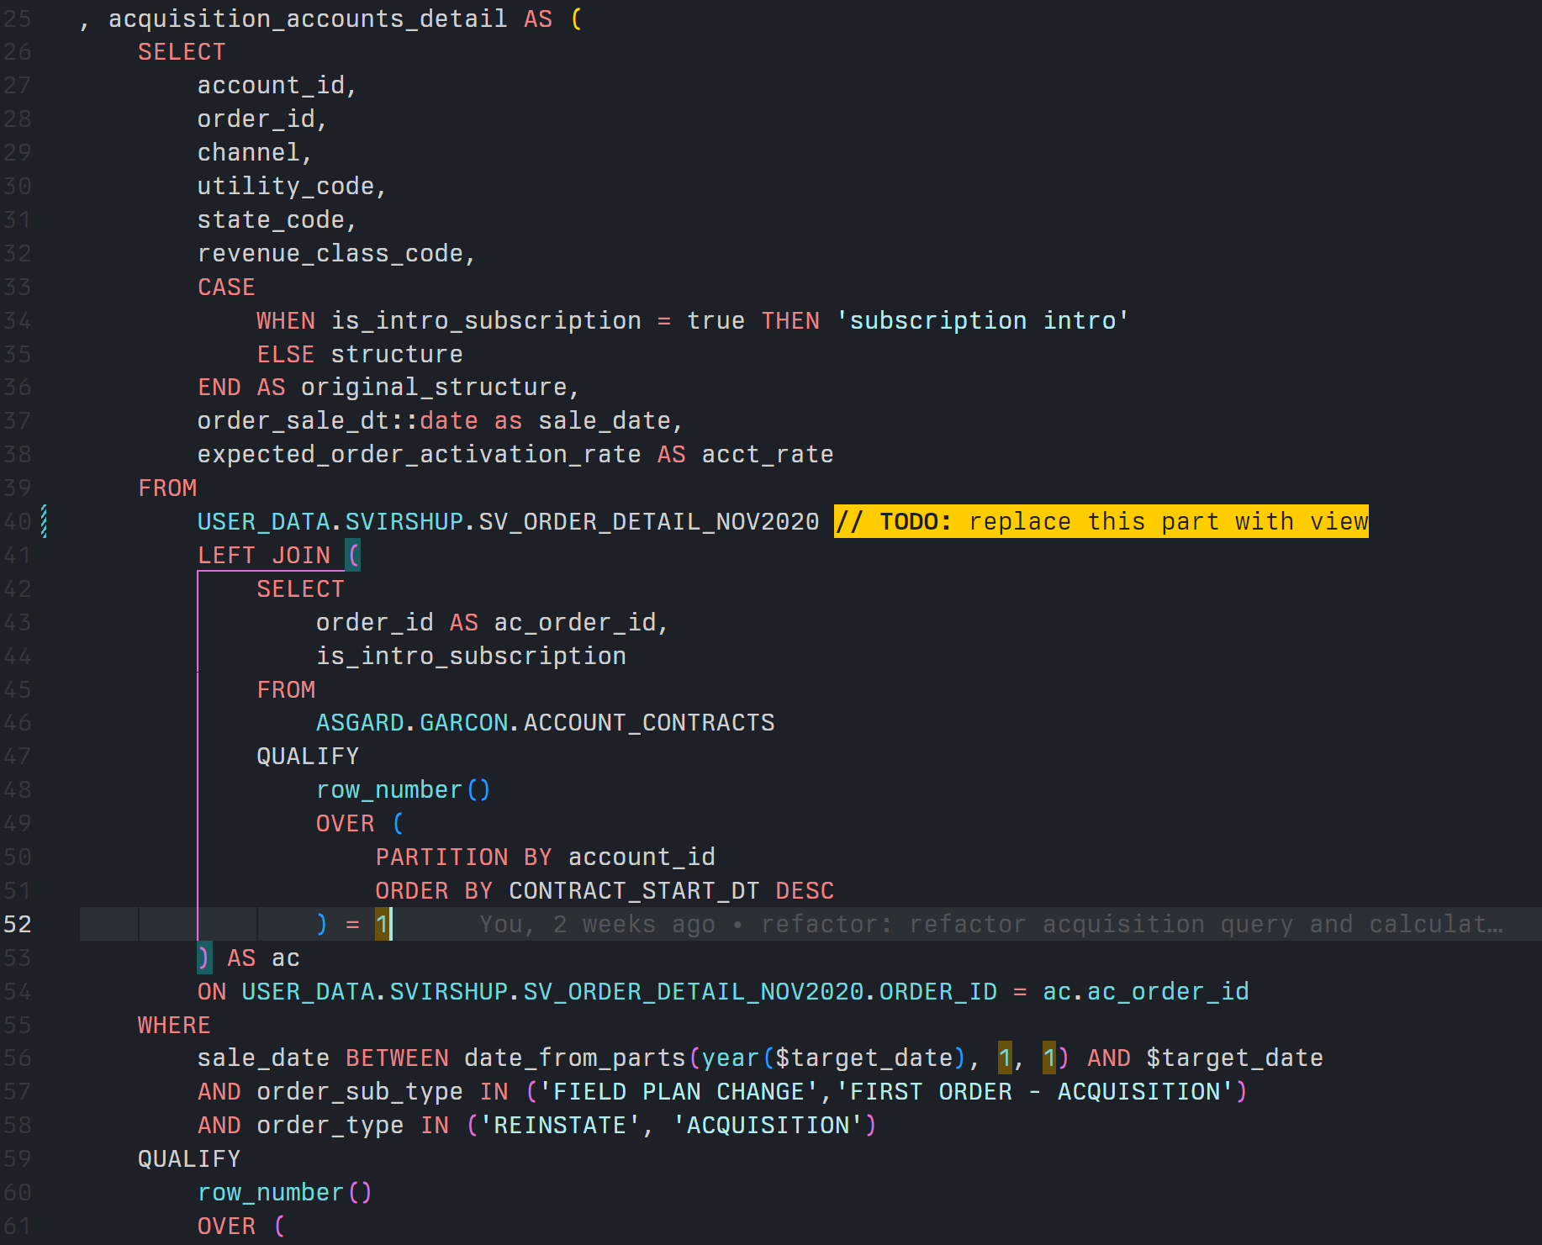



SCENARIO #1
Query (code) Editing
IDE or text editor usually come with:
Customizable syntax highlighting
Integrated git/GitHub support
Code formatting with proper indentation
Code linting
And much more…

Slide 23
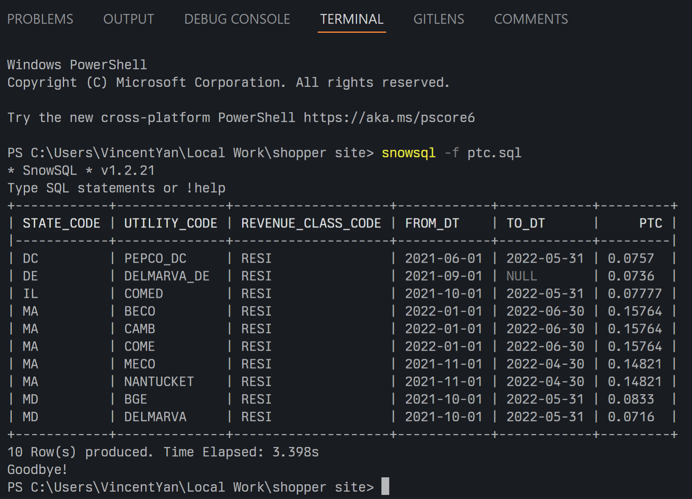
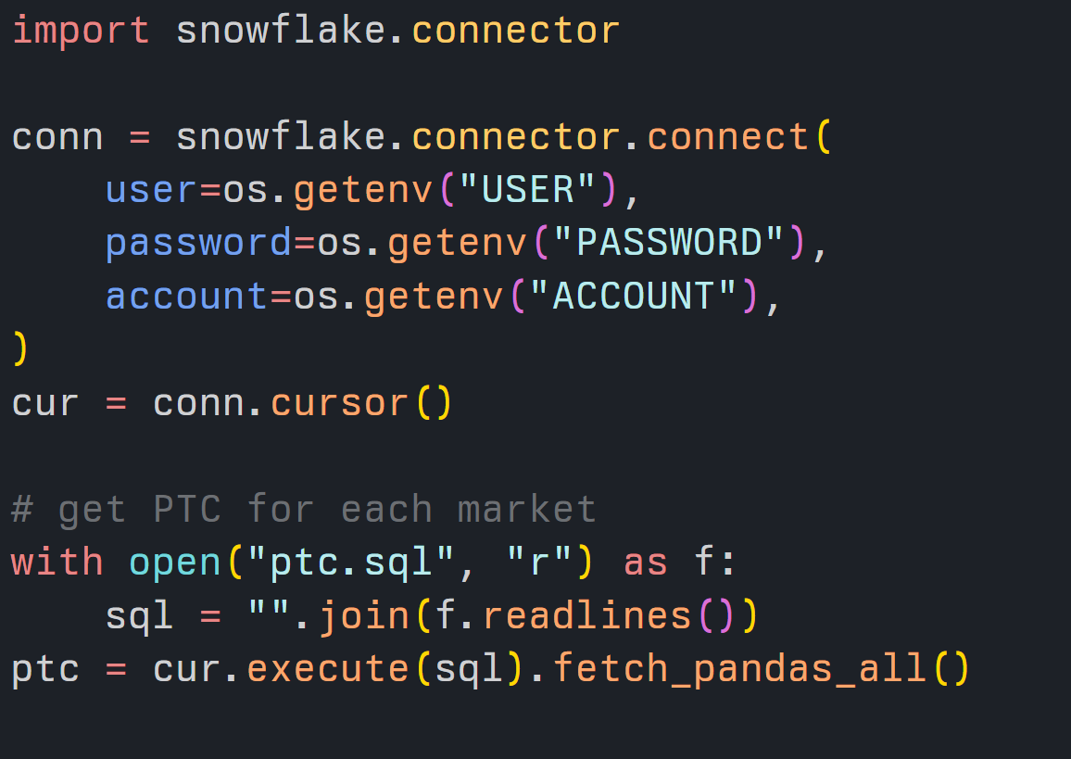
SCENARIO #1
Getting Query Result
SnowSQL
Snowflake Connector for Python
To output to .csv file:
snowsql -f {your_sql_file} -o output_format=csv -o timing=false -o friendly=false > {your_csv_file}

Slide 24
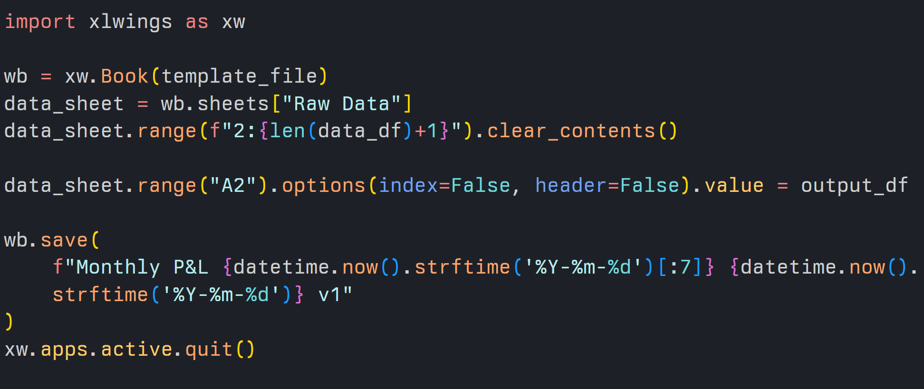
SCENARIO #1
Use Existing .xlsx File as Template
Libraries such Xlwings, Openpyxl, etc.
helps you easily write pandas DataFrame into excel file without human errors

Slide 25
Requirement: transform latest data and extract to new format on snowflake for others to use
Final delivery: a view on SnowFlake
Data is guaranteed to be latest
Occasionally we want to add more columns, or change the calculations
Scenario #2

Slide 26
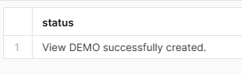
SCENARIO #2
What I use to do
1. Write, edit, test select statement
in SnowFlake Web UI
2. Create or replace table with that select statement every Monday

Slide 27
SCENARIO #2
Problems I use to get
Infrequent view definition change
Don’t remember when it is changed last time and why
Need to keep documentation somewhere else
No change history and reason is preserved
Leaving too much comments in sql code breaks SnowFlake’s formatting tool
Manual labor required to deploy the view
Cannot be sure if the current view is updated with the latest definition

Slide 28
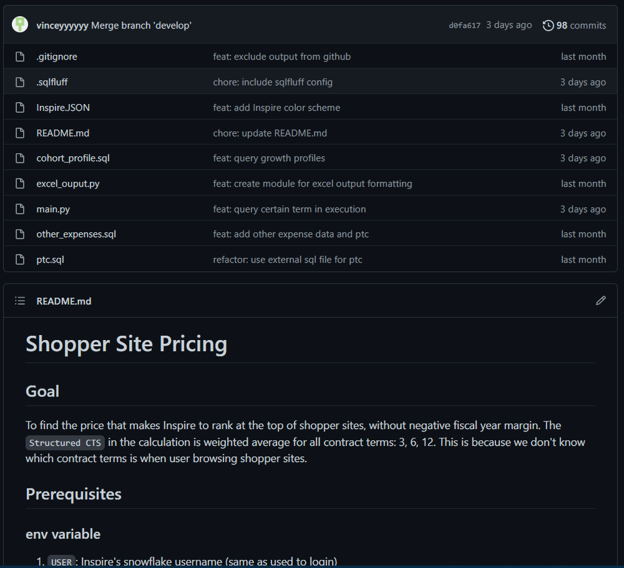
SCENARIO #2
Repository
Organizing all things belong to one single project as a repo, usually include:
README.md as documentation
Your code
Configuration files
GitHub will render your README.md file by default
Why this repo exists
How to use it
How to make changes

Slide 29
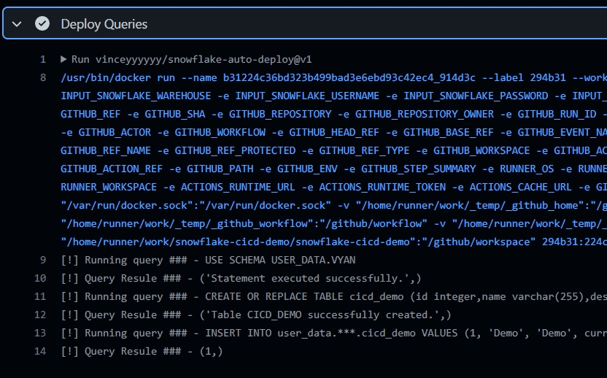

SCENARIO #2
Continuous Integration/Continuous Delivery
With GitHub Workflows/Actions, you can run task automatically when an event happens, or on schedule.
vinceyyyyyy/snowflake-auto-deploy@v1
Run sql files in the repo when a new change is merged into master branch

Slide 30
BONUS
Where to Start
Use a git client with GUI if you don’t want to touch CLI:
GitHub Desktop
Install git extensions in your IDE:
Git Graph, GitLens (VSCode)
Sign up for GitHub with you blend360 email address
Join Blend360 organization and see what other people are doing
Think it as a cloud drive with manual control, and start from there

Slide 31
BONUS
Recap
Organize your project as a repository, with documentation
Host your repo on GitHub
Use git to manage the version history and keep synced with GitHub
Create branches when make changes, then merge back
Interact with databases via their clients (SnowSQL, sql connector, etc.)
Consider CI/CD and other workflow automations

Slide 32

Thank You

